Slide 1
A unique
educational model
eLearning Innovation Center
with the support of the Faculty of Psychology
and Education Sciences
May 2024

Slide 2



Slide 3

The UOC's
educational
model
Notes:
The UOC's educational model
The way our students learn sets our university apart. They learn by doing, with projects and activities. Students manage their own time and plan their pace of study, combining their learning with their other responsibilities.
The UOC's educational model was created with the aim of meet the educational needs of people interested in lifelong learning and to optimally leverage the potential offered by the internet for learning in a flexible environment.

Slide 4
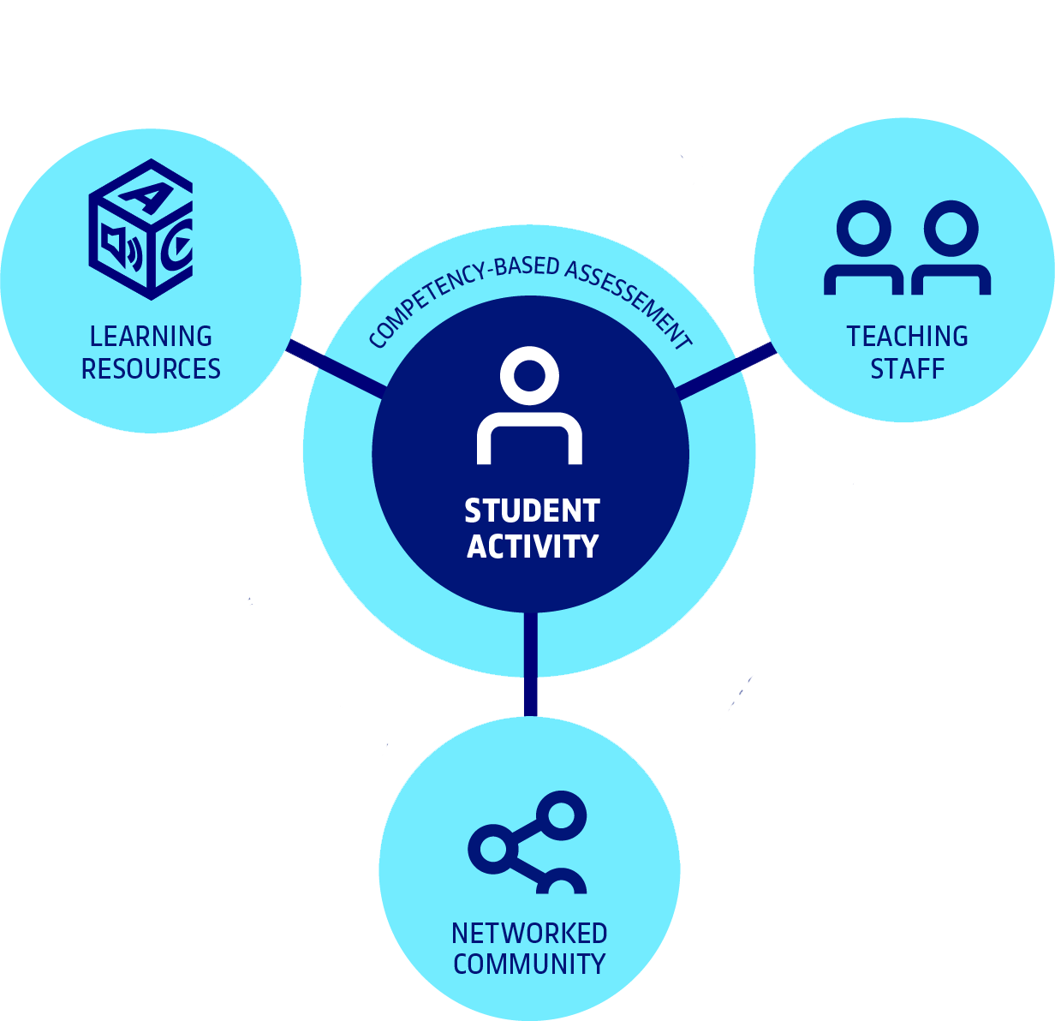

The UOC's
educational
model
The student activity as
the central factor.
At the UOC, students learn actively…
performing learning activities with the help of tools and resources throughout the semester,
working with their classmates,
receiving constant support from the teaching team,
and being assessed by competencies.
How to study
at the UOC?
Notes:
The UOC's educational model is based on five cornerstones that make up the learning experience: the student activity, assessment by competencies, teaching staff, tools and resources, and the networked community.
It is centred on the student and their learning process. The student activity become the core around which teaching is organized.
The purpose of the teaching-learning process is to enable students to develop professional skills by means of formative assessment. The assessment is continuous and guided: there is a work plan with continuous assessment activities.
The model allows each student to self-regulate their own learning process, encouraging autonomous learning that is accompanied by the teaching team (faculty member, course instructor and tutor).
The student has learning contexts that combine various resources and tools, and work dynamics based on support from the teaching team and interaction with classmates.
The UOC's model is dynamic and flexible, and enables diverse learning situations. It is designed to constantly adapt and evolve over time, as the internet and the knowledge society evolves. It therefore ensures that students learn in a similar way to how they work and communicate online.

Slide 5
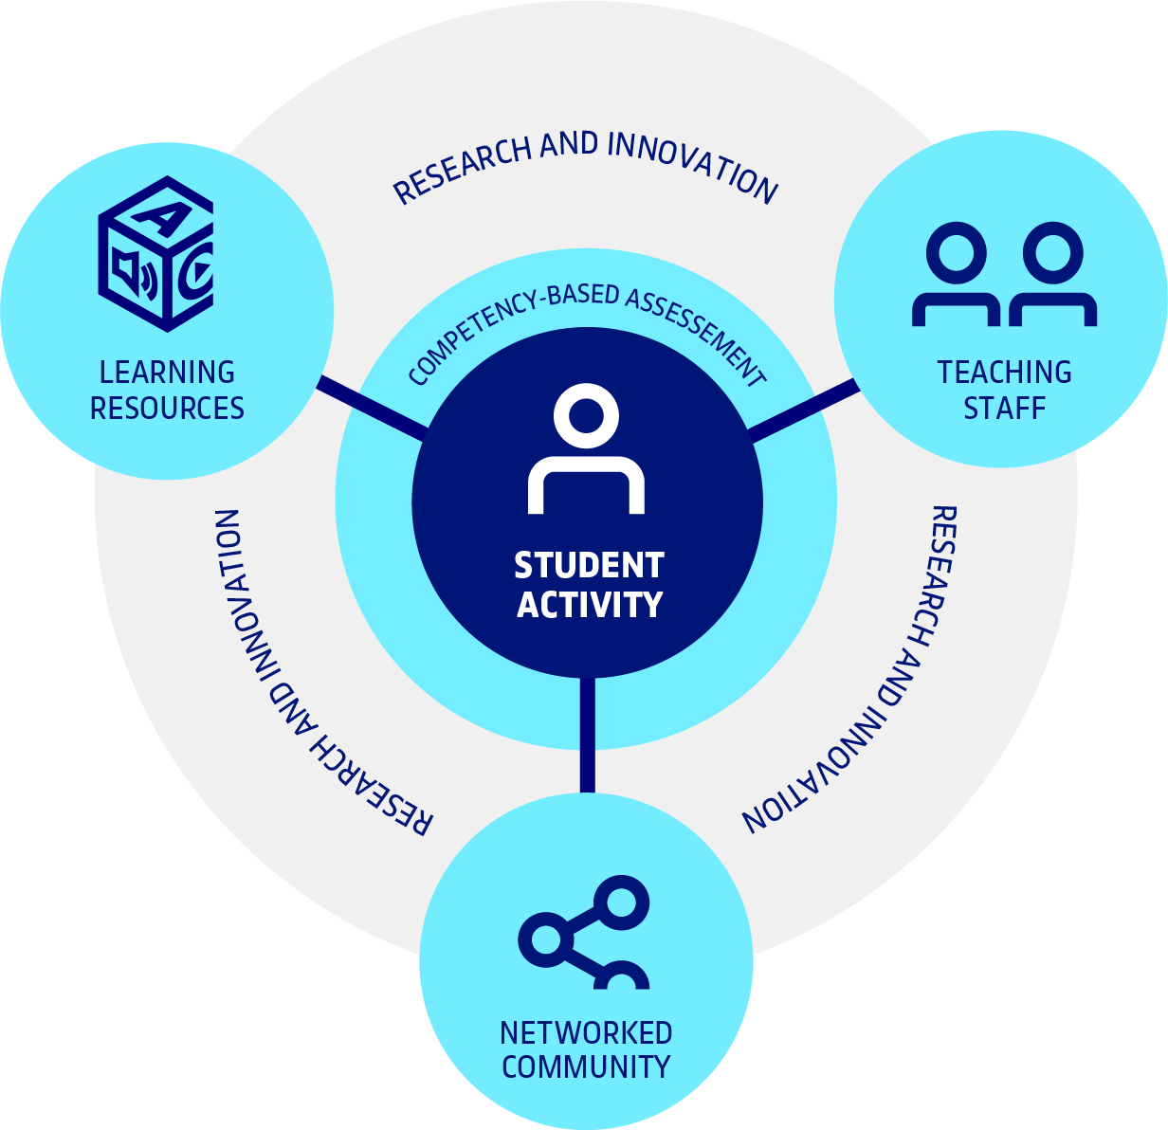
The UOC's
educational
model
The educational model draws on research and innovation
in e-learning.
The IN3, eHealth Center and faculty members at the UOC focus their research on the field of e-learning.
The eLearning Innovation Center ensures that
the educational model evolves and is updated, taking methodological and technological trends into account,
and enabling their implementation.
Notes:
Our model draws on the research carried out by the IN3 and eHealth Center and the UOC faculty members, whose research focuses on the field of e-learning.
The eLearn Center is a nucleus of innovation in e-learning. It nurtures the development of the educational model, taking into account the methodological and technological trends that may be applicable to the UOC. From a practical point of view, this involves implementing changes and improvements in the design of degrees and courses.

Slide 6

The learning process

Slide 7

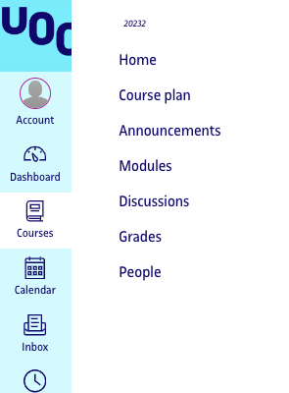





The learning process
The virtual classrooms are the environments where the learning process takes place, and where each course is taught.
Notes:
UOC students learn on a virtual campus, where they have access to a comprehensive range of learning tools. The learning involved in their various courses takes place in classrooms, which include:
The course plan, which documents the structure of the course’s teaching and learning process.
Learning activities, presented in the timeline to facilitate planning and staying on track throughout the semester.
The assessment area, where continuous assessment activities are submitted and feedback is returned.
Contact details of the teaching staff.
Communication channels: noticeboards, forums, etc.

Slide 8
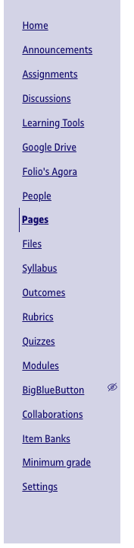
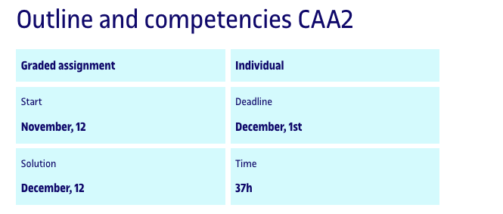





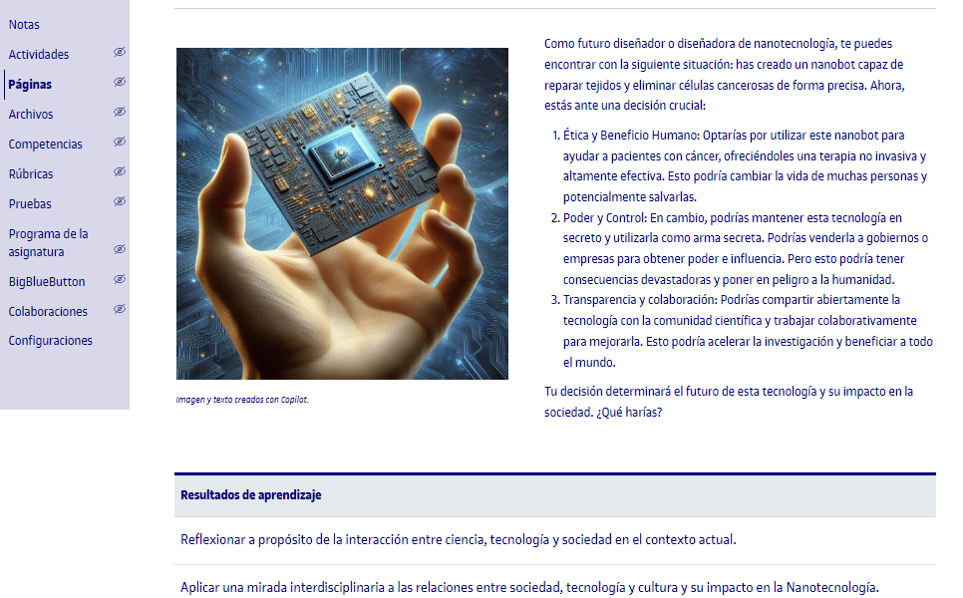



The learning process
Challenge-based learning.
Notes:
Students carry out training activities in which they must respond to challenges, finding solutions for professional or formative situations.
The objective of these activities is to develop the skills, knowledge, attitudes and values related to the competencies in the programme.
The learning design is therefore focused on the student having an active attitude and sufficient motivation, being able to be continuously engaged in terms of the knowledge and the competencies to be acquired, and being able to interact frequently with the teaching team and the other students.
The learning therefore has a very important social component; for this reason, the UOC uses the most advanced technological and communicative tools in its educational activities to facilitate interaction between students and teachers:
Social tools that facilitate interaction and knowledge sharing (blogs, wikis, microblogs, social bookmarking, etc.).
Synchronous and asynchronous communication systems that enable smooth and clear communication adapted to each situation (video chats, forums, video blogs, etc.).
Immersive environments enabling interaction with people and objects, simulating real situations.
Easy access to content and learning using different types of mobile devices, allowing the student to learn anywhere, anytime.

Slide 9

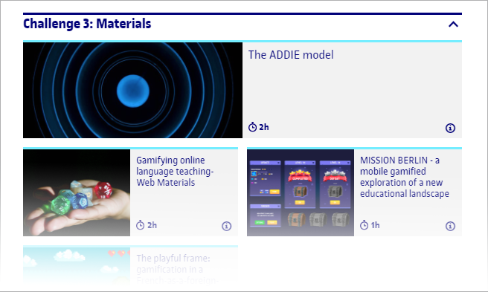






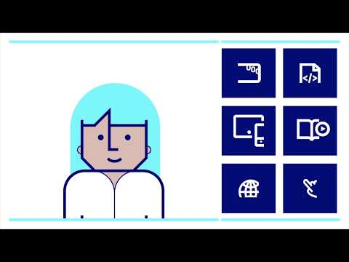

The learning
process
The digital learning resources are cutting edge and adapted to the student.
The digital learning resources adapt
to you
Notes:
Students have the learning resources they need for each educational activity in the classroom. These include all types of digital resources in various formats (video, audio, web, e-books, etc).
The UOC resources are multimedia and interactive, and are available for various devices (PC, tablet, mobile phone). They are also accessible and adapted for the visually and hearing impaired.
Students also have a wide range of services available from the virtual library.

Slide 10

Support

Slide 11

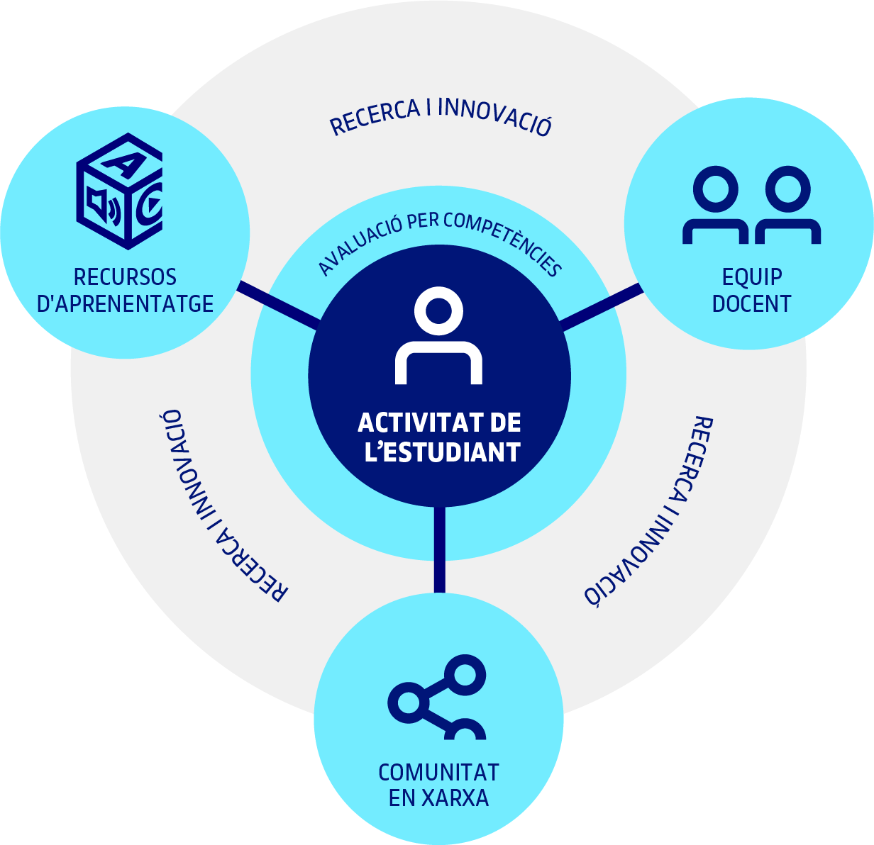



The UOC
teaching staff
The teaching team provides students with personalized support and ongoing guidance throughout the course of their studies.
PROFESSOR
(PDI)
TUTOR
PROGRAMME
DIRECTOR
COURSE
INSTRUCTORS
Notes:
Students are mentored on an ongoing basis by specialist teachers, whose primary tasks are to design, guide, enhance and assess their entire educational process.
There are three teaching profiles – coordinating professors, course instructors and tutors – who work together to ensure a quality learning process. The programme director coordinates the coordinating professors (who are UOC faculty members) and ensures that the range of competencies targeted by the programme is up to date and appropriate, and that the programme is academically and methodologically coherent.

Slide 12







Responsibilities
of tutors
They advise students on the choice of a personal academic pathway during their time at the UOC.
They welcome (first academic tutor), support and guide students on a person-by-person basis during their academic life at the UOC.
TUTOR
COORDINATING PROFESSOR
What sort of guidance can
the UOC's tutors provide?
STUDENT
COURSE INSTRUCTOR
Notes:
The tutor guides the student in their selection of a personal academic pathway during their time at the UOC.

Slide 13





Responsibilities
of coordinating
professors
They design the course, ensure its quality and coordinate the course instructors.
Evaluate the results
of teaching and assess the design
the course
Design the course and
take academic decisions
Lead and work collectively with course instructors
to establish the teaching-learning process for
the course
Stay constantly up to date in their area of expertise and lead
teaching innovation
Monitor teaching
Notes:
The course's coordinating professors design the course, ensure its quality and coordinate the course instructors.
Their main responsibilities are to:
Design the course and take academic decisions
Stay constantly up to date in their field of expertise and lead teaching innovation
Monitor teaching
Evaluate the results of teaching and assess the design of the course
Lead and work collectively with course instructors to establish the teaching-learning process for the course

Slide 14

Responsibilities
of course
instructors
They assess and guide students' learning process in
a given course.
They assess students’ learning and provide
feedback
They assess teaching
and participate in improving
the course
They train and stay up to date in the field of online teaching and in their area of knowledge
They contribute to planning the teaching-learning process under the supervision of the coordinating professors
What sort of guidance can
the UOC's course instructors provide?
They monitor and give life to the classroom and students’ learning processes
Notes:
Course instructors advise on, guide and monitor the student's learning process throughout the course.
Their main responsibilities are to:
Assess students' learning and provide constructive feedback
Train and stay up to date in the field of online teaching and in their area of knowledge
Monitor and give life to the classroom and students’ learning processes
Evaluate teaching and participate in improving the course
Contribute to planning the teaching-learning process under the supervision of the coordinating professors

Slide 15

Assessment

Slide 16











Assessment is continuous, formative, digital, inclusive
and ethical, authentic
and competency-based, providing certification and integrating IA.
The competence assessment process
Notes:
Assessment at the UOC is structured around continuous assessment and final assessment. There are also special assessment models for internship courses, master's degree final projects and postgraduate final projects.
Continuous assessment takes place throughout the semester. It is the cornerstone of the UOC's educational model, and is applicable to all the courses in the training programmes offered by the UOC. Continuous assessment is the assessment model recommended by the UOC, and the one that is best suited to its students' profile. It also facilitates the progressive attainment of competencies.
Students receive a final continuous assessment mark at the end of the semester, reflecting the knowledge and competencies learned.
Depending on the assessment model for the course, the continuous assessment final mark may be combined with a final test (which may be a summary test or an examination for assessment of the course as a whole).

Slide 17



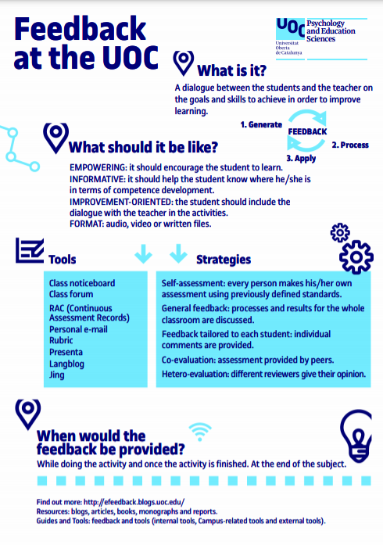



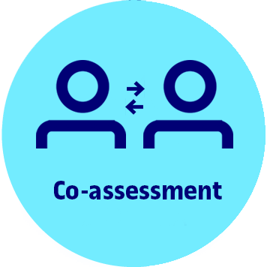
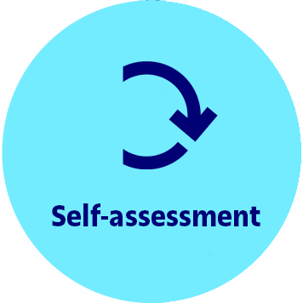





Formative
feedback
at the UOC
Dialogue between students
and teachers on goals and competencies to enhance learning.
MOTIVATING
INFORMATIVE
ORIENTED TOWARDS
IMPROVEMENT
Feedback: a tool for lifelong learning
Notes:
Formative feedback tells students what competencies they have developed and what goals they have achieved, what they have yet to achieve, and what they have to do to achieve it.
The feedback is planned before the start of the course, and is part of the course design. It is defined according to the type of activities that are included.
The feedback is given to the student throughout the semester, as they perform the different tasks or activities.
It can come from the teacher, classmates, external experts or self-assessment. Corrections must be presented in a motivational manner, with questions and suggestions for improvement.

Slide 18




UOC.universitat
@UOCuniversitat
@uocuniversitat
uoc.edu

